Slide 1

Appointment Bot
Mini Project by:
Srushti Narvekar (16IT6154)
Sneha Kanase (16IT6152)
Akshay Dangare (17IT1075)
Mentor :
Anita Patil Ma’am

Slide 2
Introduction
With all the busy environment, and increasing routine care, its necessary to have a assistant on your daily WhatsApp to guide you throughout. Chatbot applications streamline interactions between people and services, enhancing customer experience.
Assistant Bot helps you schedule your routine activities with reminding you by Google Calendar.
The objective of the thesis is to maximize the convenience to schedule appointments without getting overwhelmed with calls.
Hassle-free appointment scheduling: Patients don’t always have the time to visit the doctor’s clinic personally for making an appointment. A chatbot makes it utterly convenient to manage the requests and confirm them accordingly.
Immediate Patient Assistance: Some matters are urgent and need an on the spot expert opinion. A chatbot can be instrumental in bridging the gap between patients seeking answers and expert doctors who can help.
Saves Time: Both the patient and the clinic staff save the time they spend on scheduling an appointment. Patients can now book an appointment right from their office desk or from the comfort of their home.

Slide 3
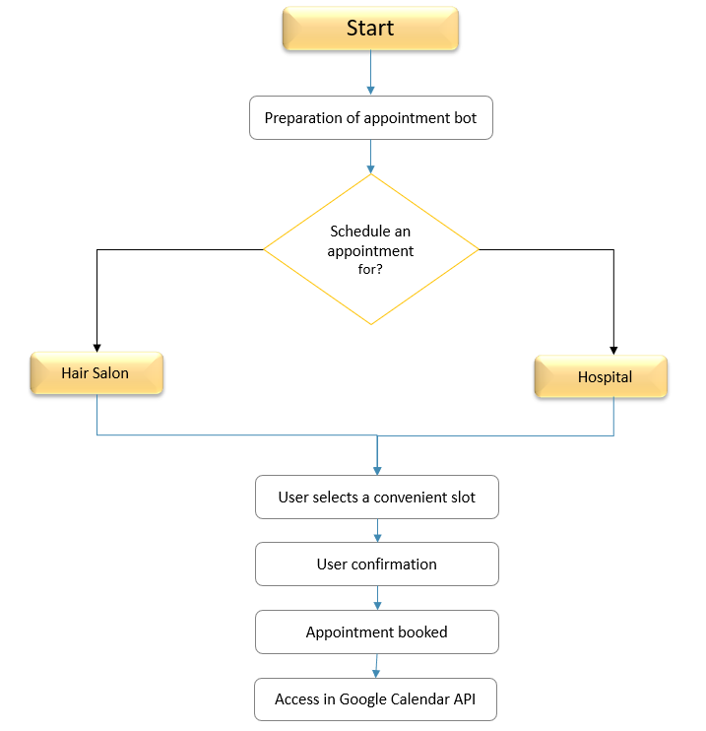

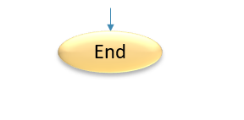
FLOWCHART

Slide 4




Methodology
Dialogflow
For creating intents
Deployment
For dumping Dialogflow intents
Hosting with Heroku
Access anytime anywhere
Step 4
Twilio Account
To access WhatsApp for our Chatbot
Step 3
Step 2
Step 1

Slide 5
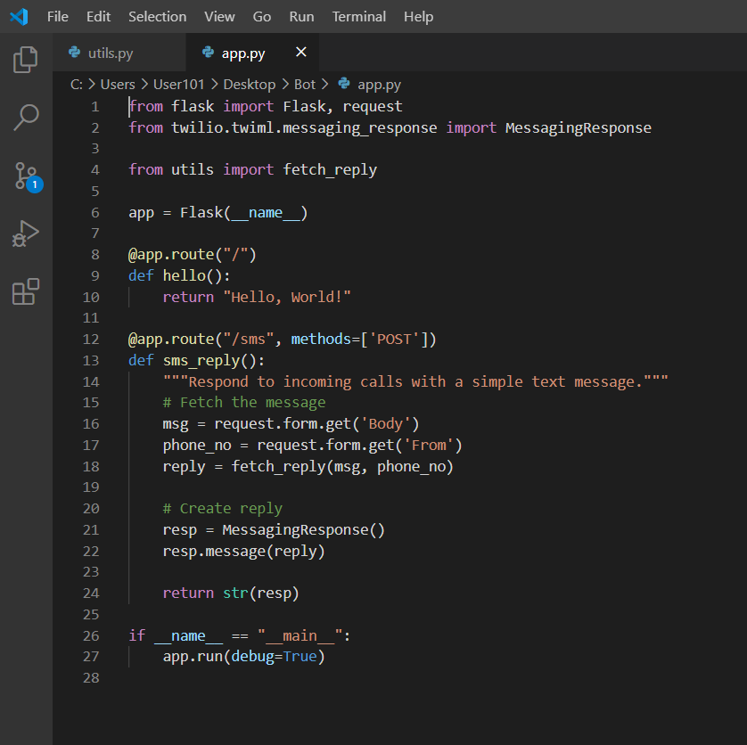
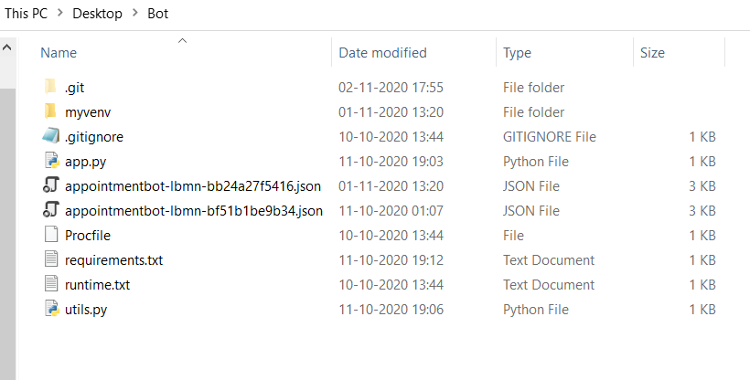
Hosting screenshots

Slide 6
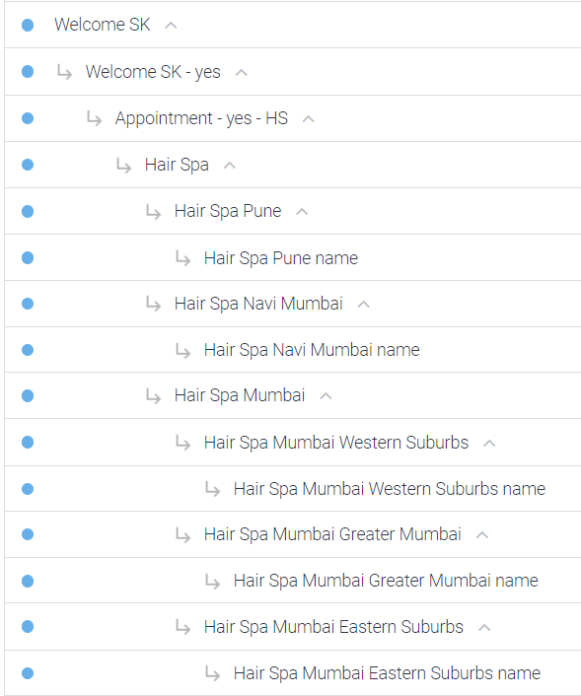
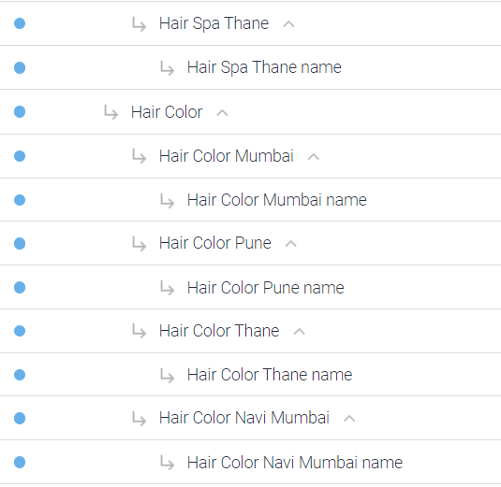
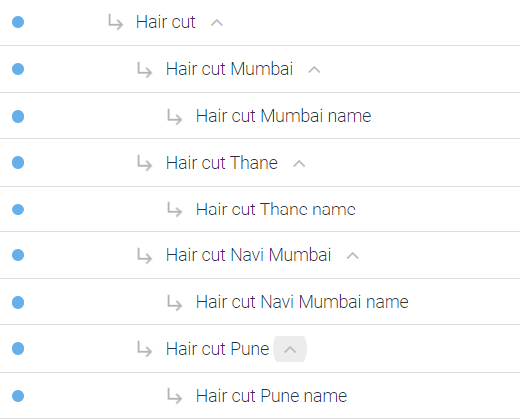
Dialogflow Intents

Slide 7
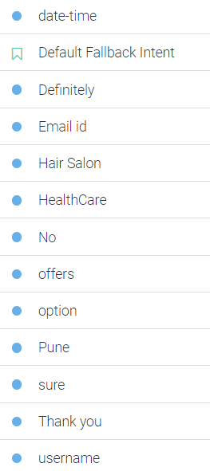
Dialogflow Intents

Slide 8
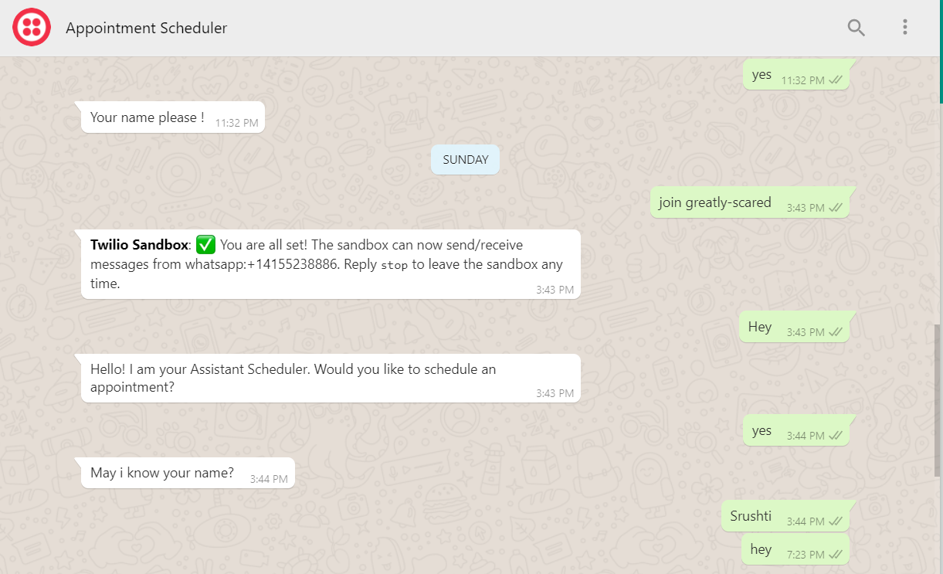
WhatsApp Hosting
Text +1(415) 523-8886 to use the bot
And key: join greatly-scared

Slide 9
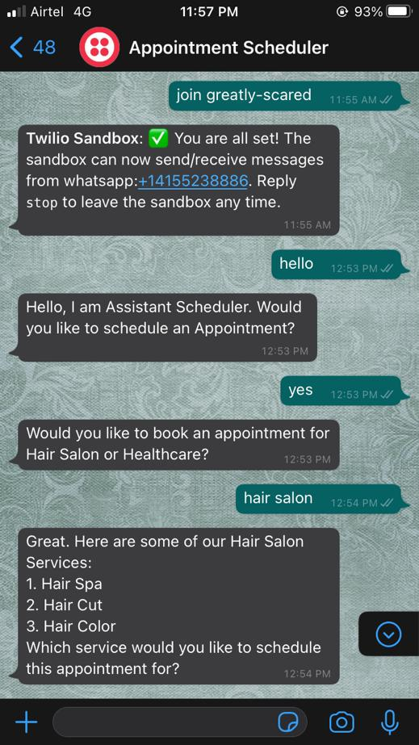
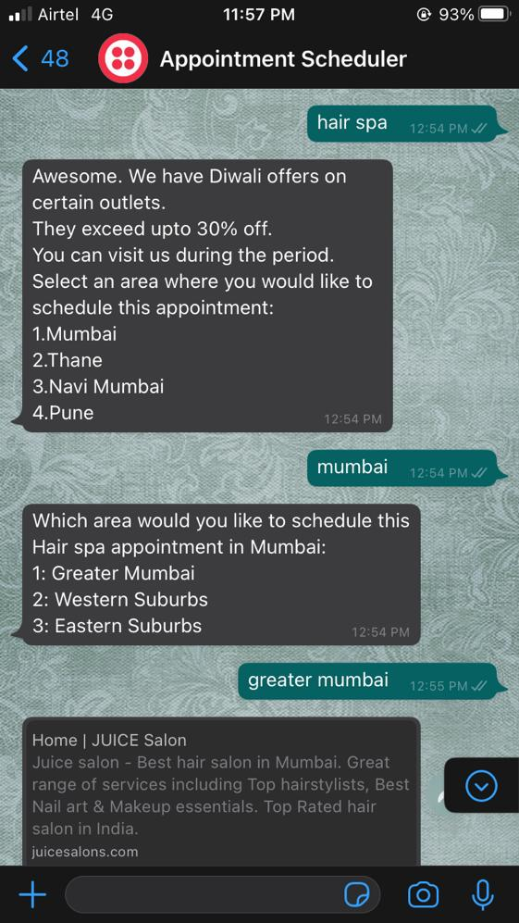
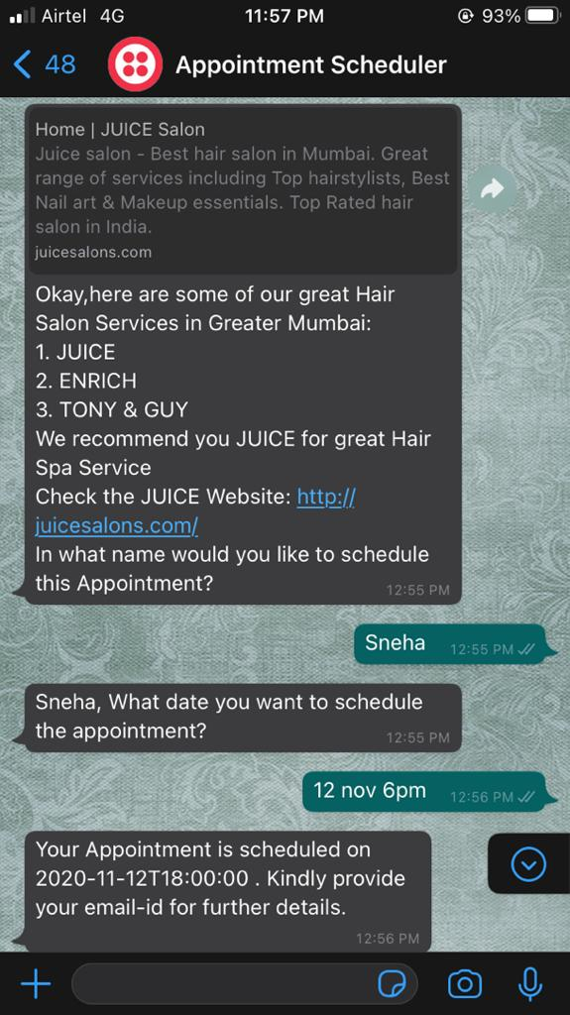
Implementation screenshots
Hair Salon Intents (Hair Spa)

Slide 10
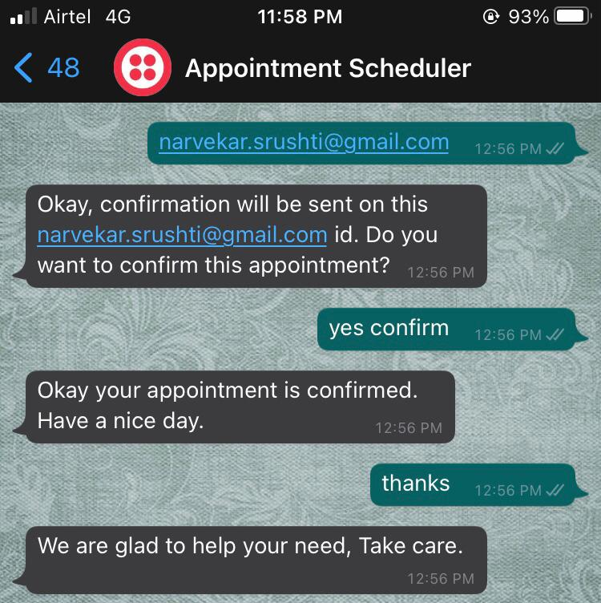
Implementation screenshots
Hair Salon Intents

Slide 11
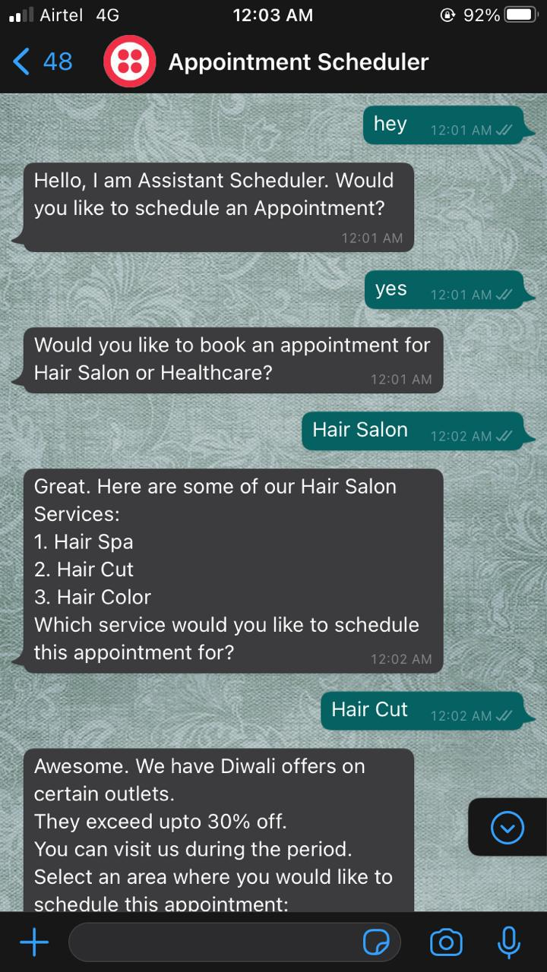
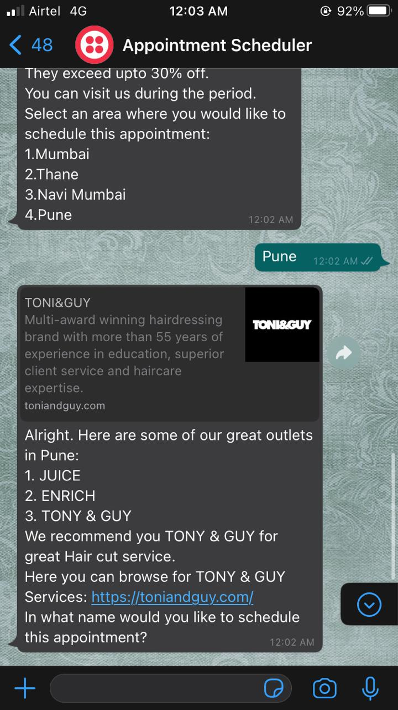
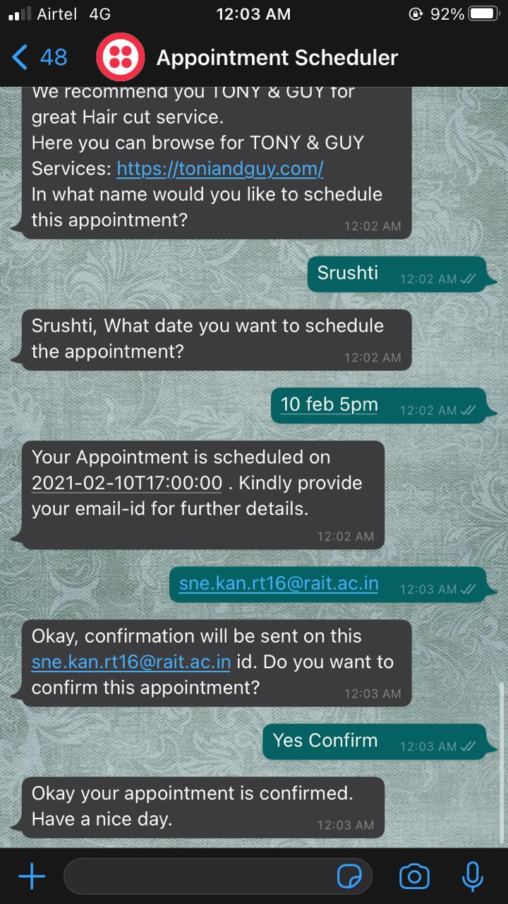
Implementation screenshots
Hair Salon Intents (Hair Cut)

Slide 12
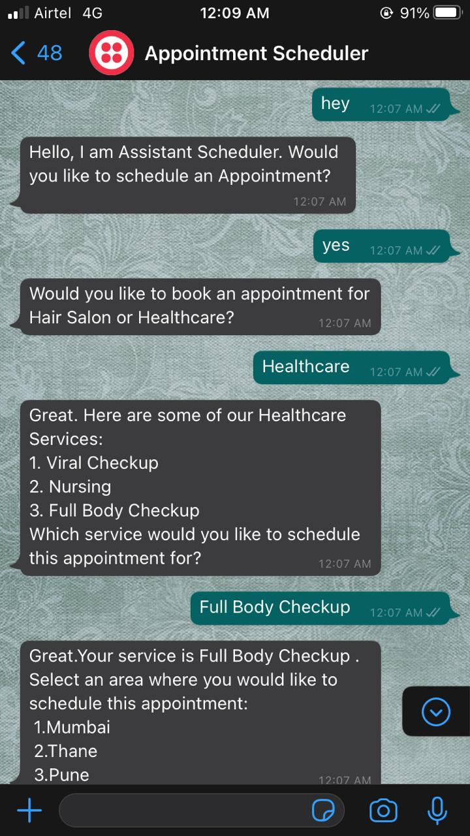
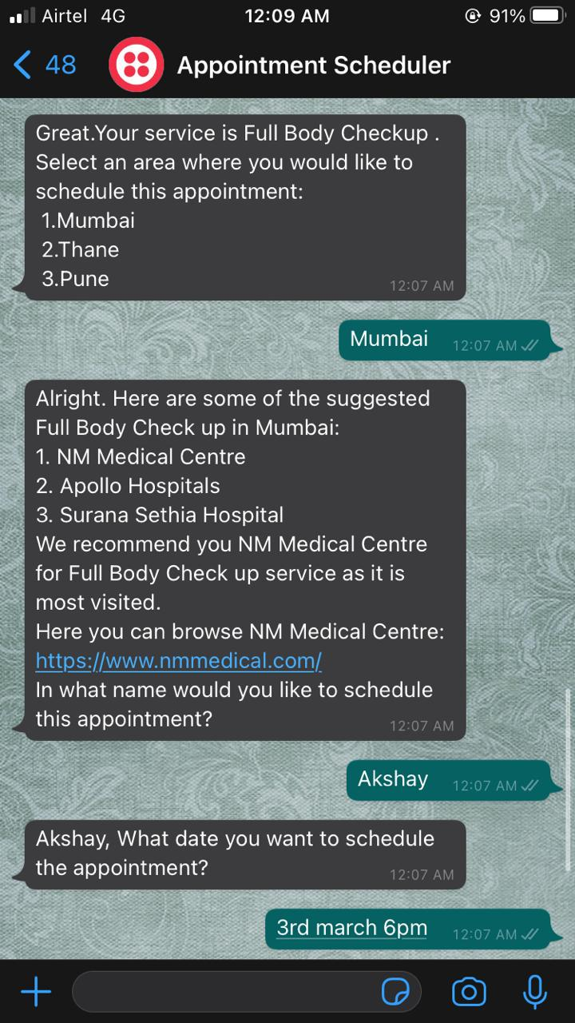
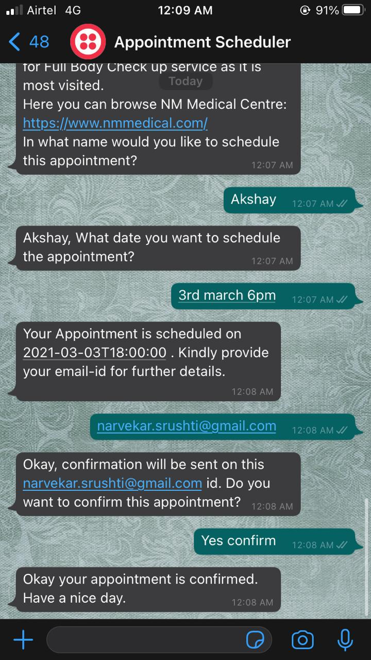
Implementation screenshots
Healthcare Intents(Full Body Check-up)

Slide 13
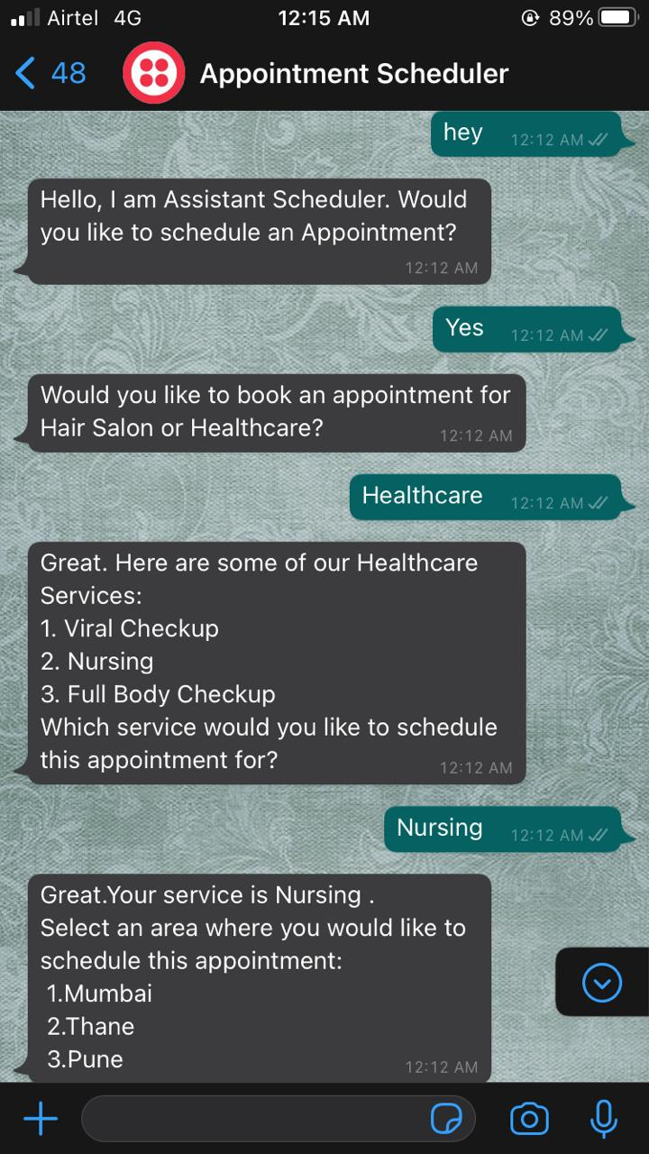
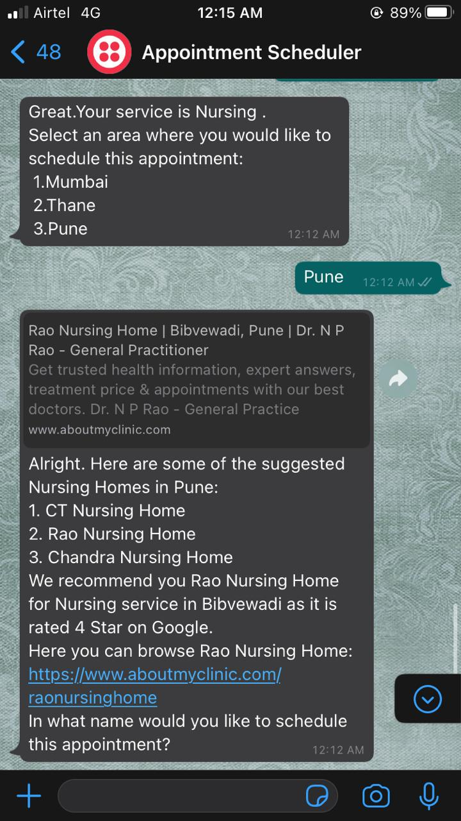
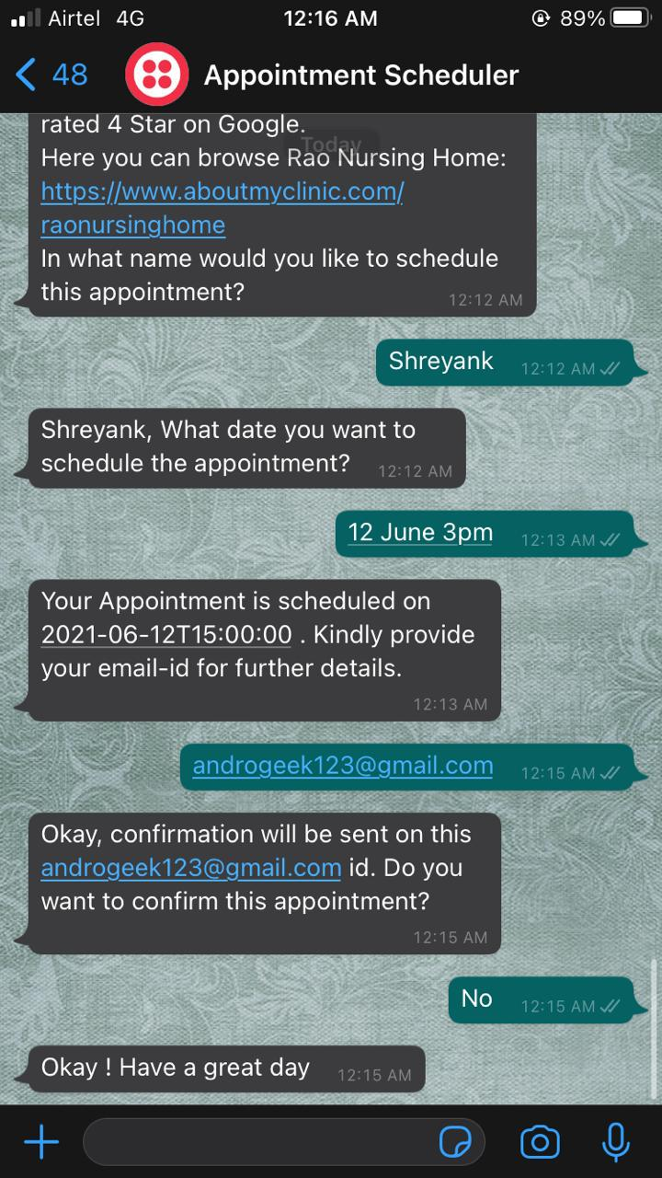
Implementation screenshots
Healthcare Intents (Nursing)

Slide 14

ChatBot
Implementation on WhatsApp

Slide 15
Thank You
Book with us anywhere anytime

